Slide 1
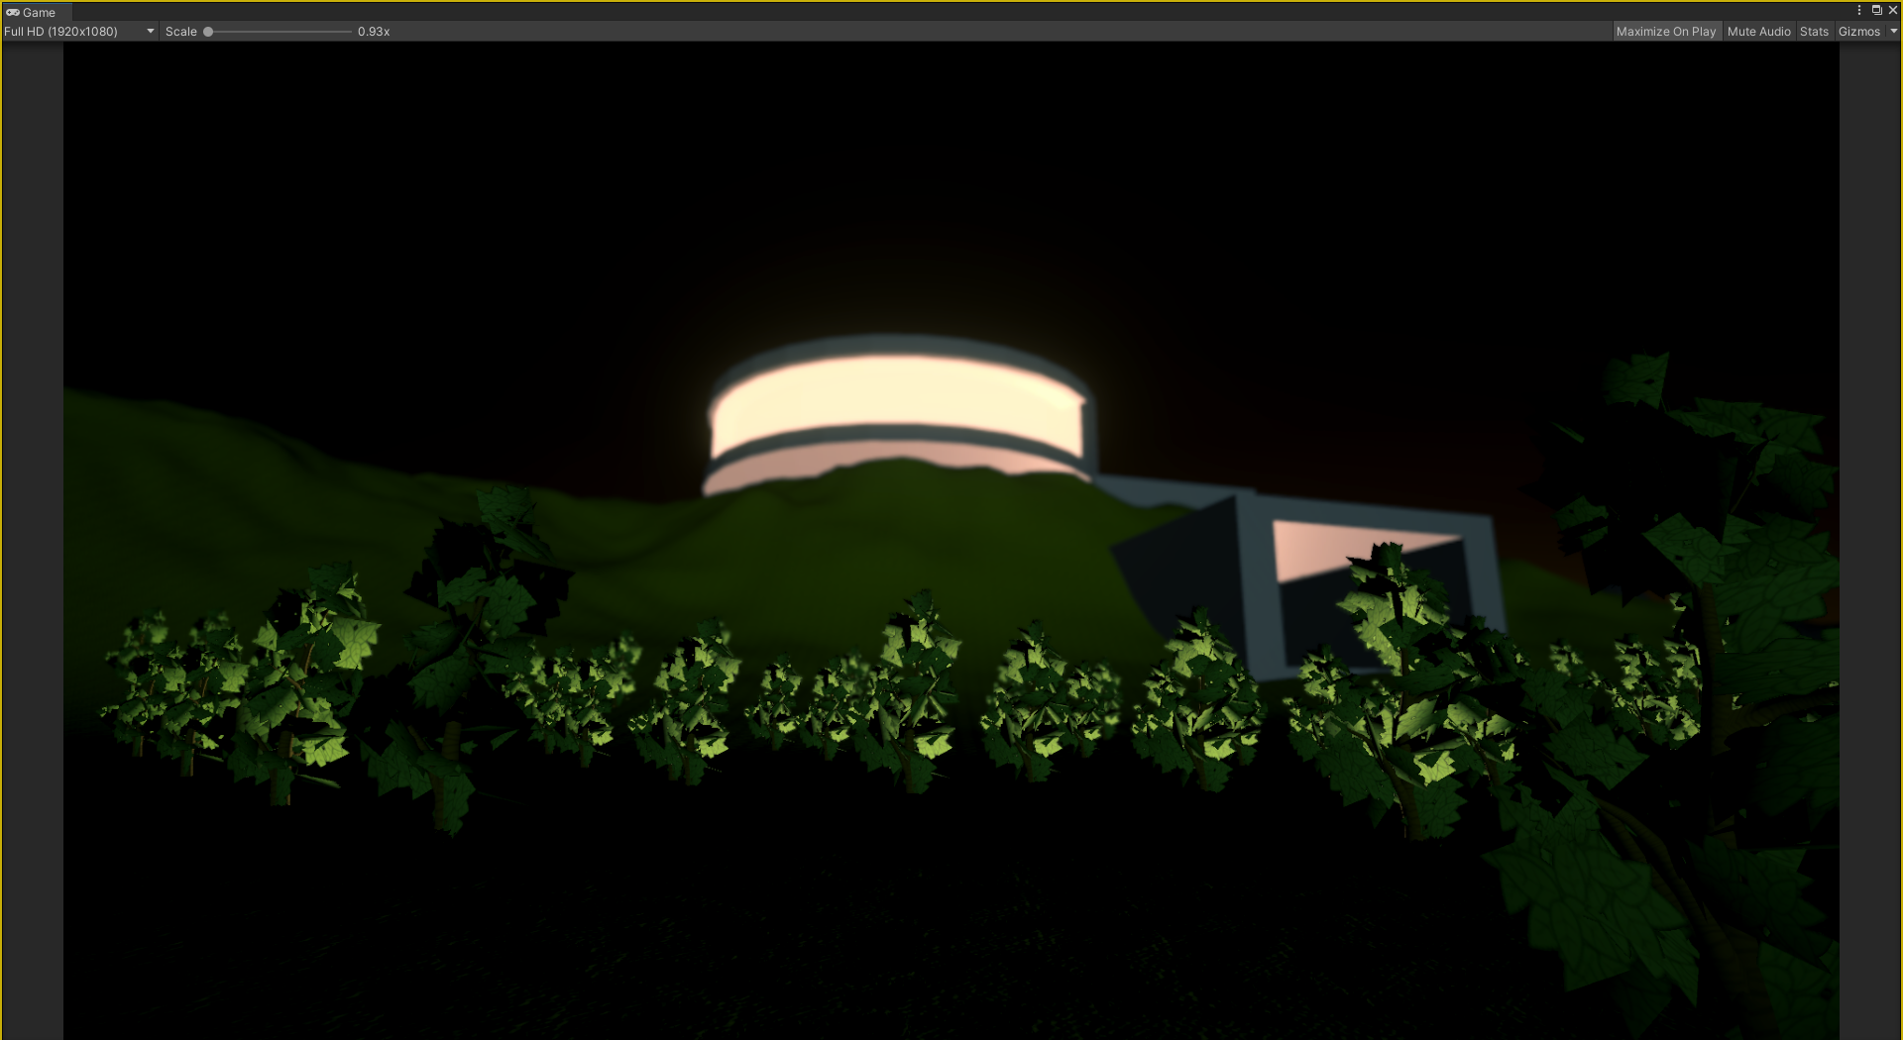
Robotco Headquarters - 2050

Slide 2
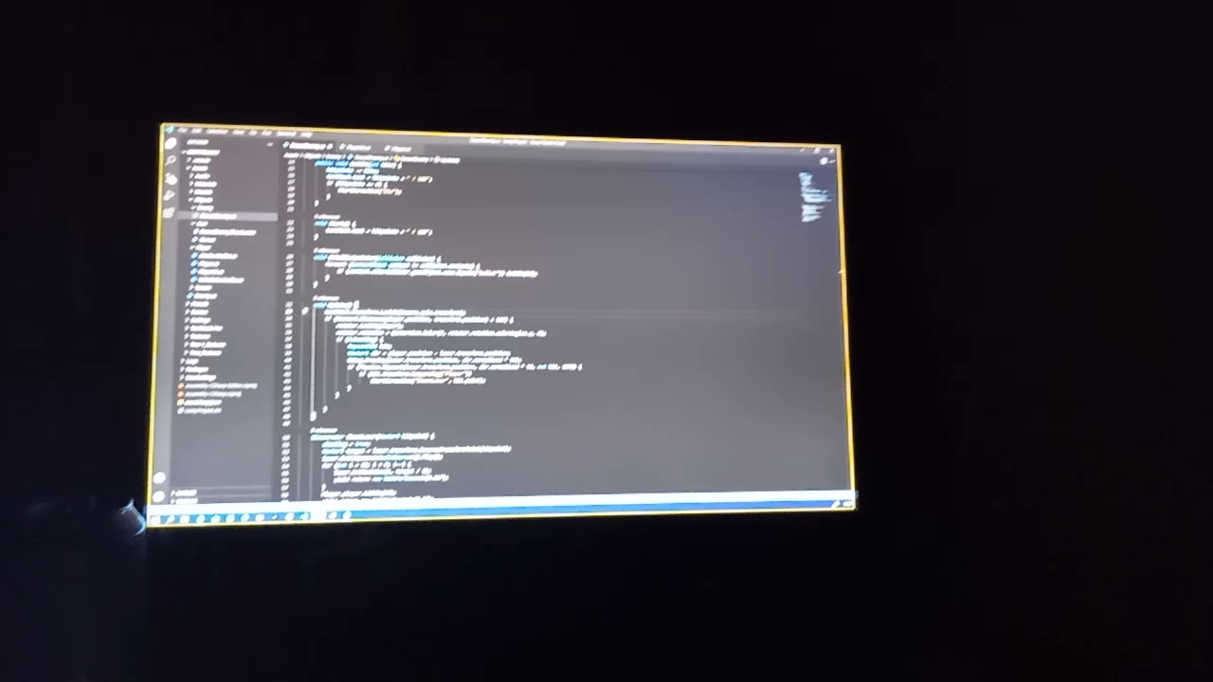
Robotco Headquarters – Mainframe

Slide 3
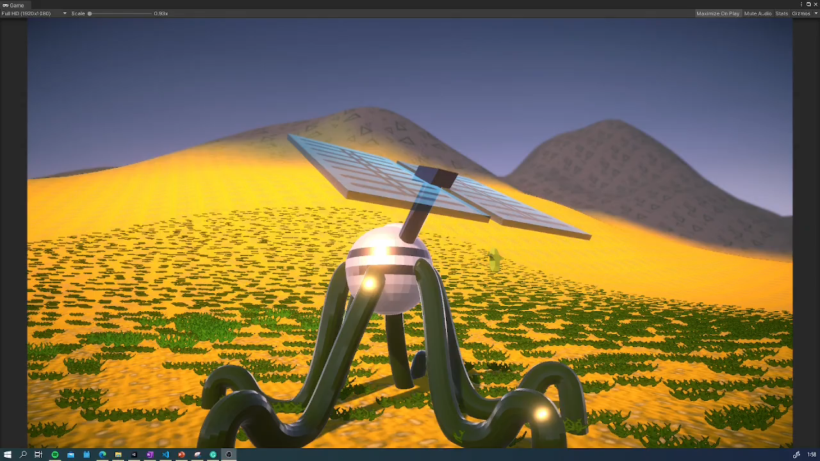
Robotco Mining fields

Slide 4
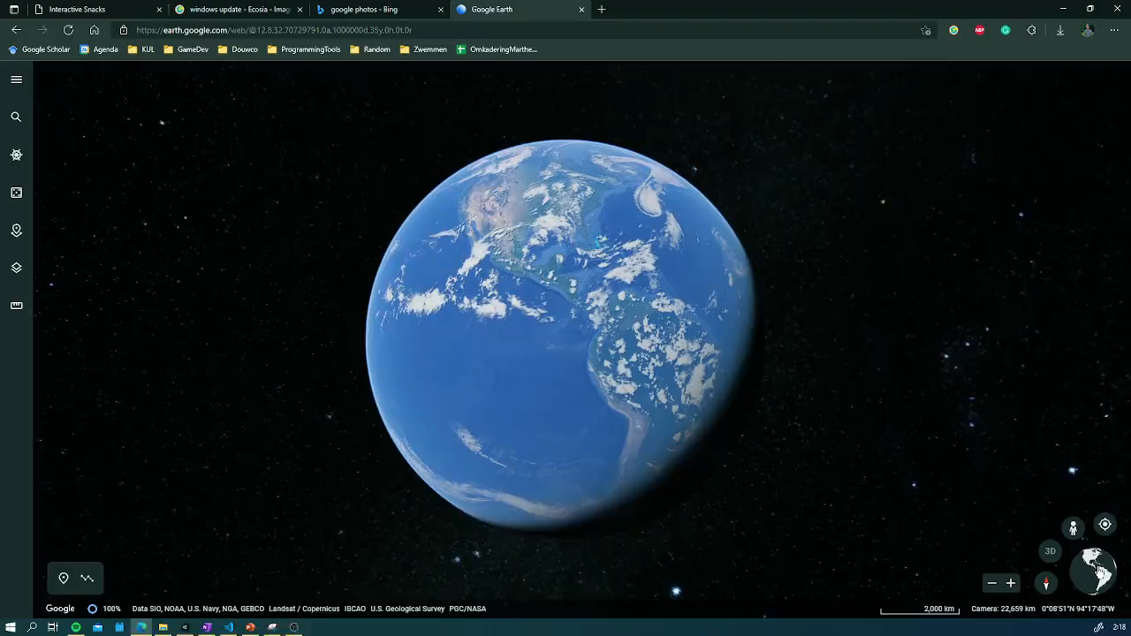
The entire world gets attacked…
All electronics went unstable...
Governments are powerless…

Slide 5
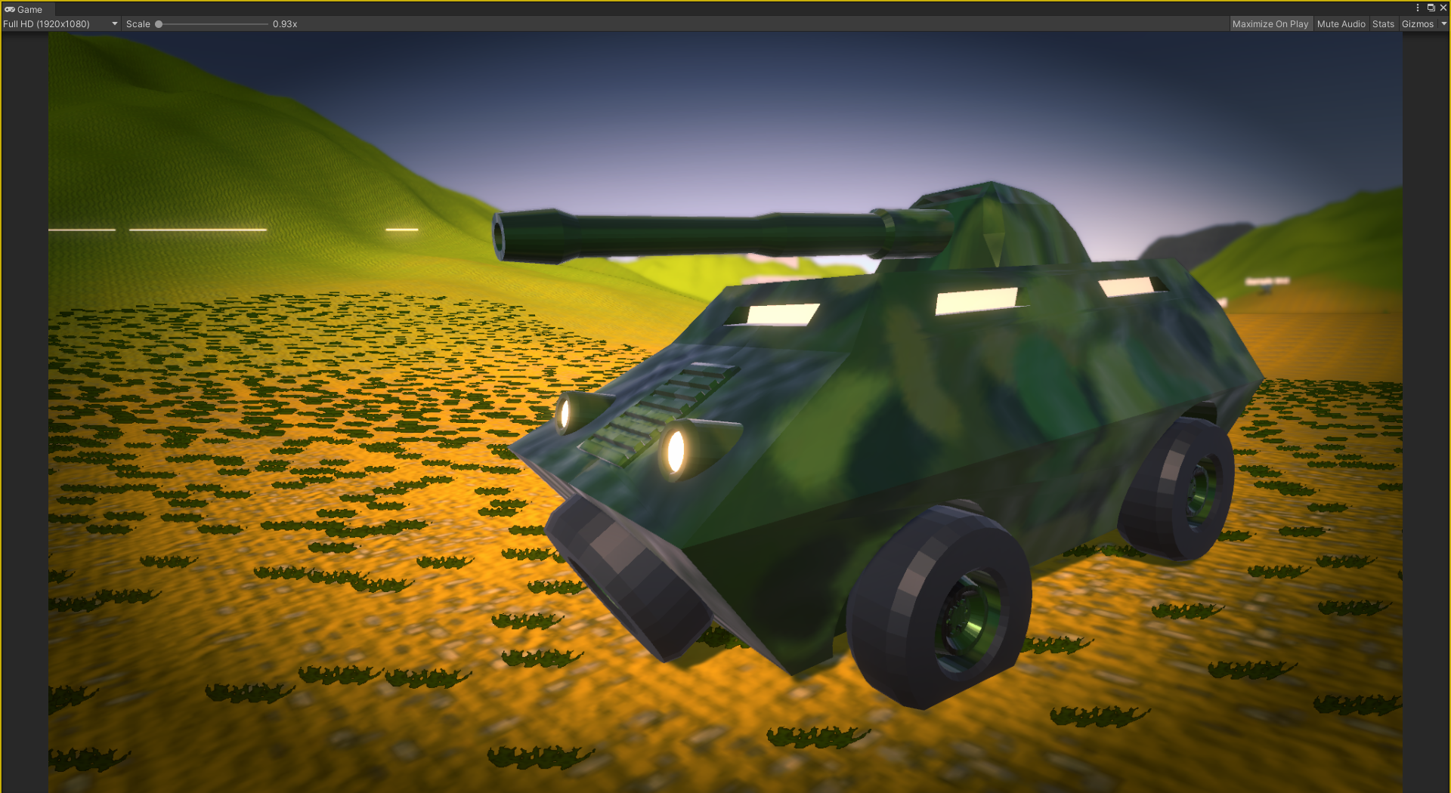
It’s time for you, to save the planet
by going to the Robotco headquarters and
stabelize the source code!
Luckely your collector military vehicle is still intact…

Slide 6
Working on updates 0% complete.
Don’t turn off your PC. This will take a while.

Slide 7
Oh dear, something terrible went wrong…
Some unstable code enables AI to take over the system.
Please shut down pc immediately.

